Slide 1
2009 H1N1 Influenza Virus
Carlotta and Mossa

Slide 2
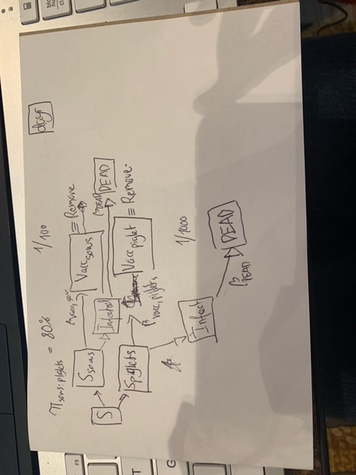

Slide 3
OutcomeS of interest
Number of infected animal
Duration of epidemic
Simulate three different scenarios:
Normal spread (no prevention).
Prevention scenario 1: Removing clinically infected pigs.
Prevention scenario 2: Vaccinate all pigs with a vaccine that reduces the susceptibility by 50%.

Slide 4
Setting
Pig farm in Italy
Two population
55 pigs (small farm)
365 pigs (big farm)

Slide 5
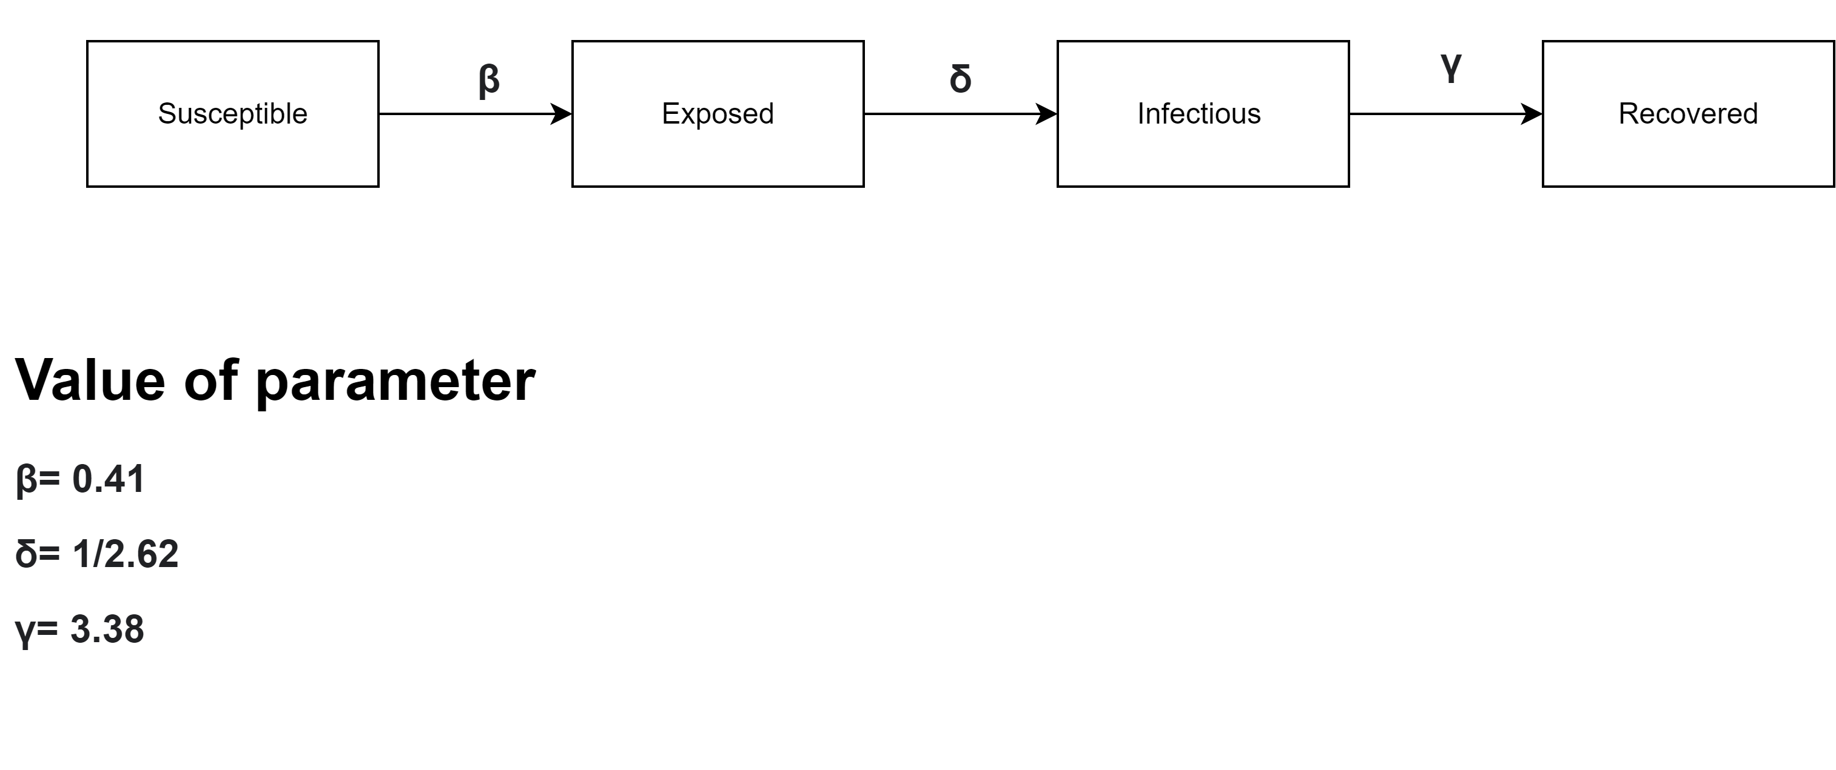
Parameter
Time period: 1 year
Not applicable for Normal spread (no prevention).
Reference: Modeling the initial transmission dynamics of influenza A H1N1 in Guangdong Province, China

Slide 6
Assumptions
Pigs are in the same room
Density – dependent
For scenario 2: Removal of sick animals once a week
Compliance: 70%
For scenario 3: vaccination reduces the susceptibility by 50%
250 repetitions of each scenario

Slide 7
ResultS:
Scenario | Small farm N pigs | Farm 1 N days | Farm 2 N pigs | Farm 2 N days
Normal spread | 42 (sd 18.2) | 36 days (sd 15.9) | 275 (sd 130) | 49 (sd 22.2)
Removing clinically infected pigs | 42 (sd 18.2) | 37 (sd 16.7) | 279 (sd 127.2) | 50 (sd 22.4)
Vaccination | 10 (sd 13.4) | 21 (sd 20.8) | 71 (sd 90.4) | 47 (sd 49.3)

Slide 8
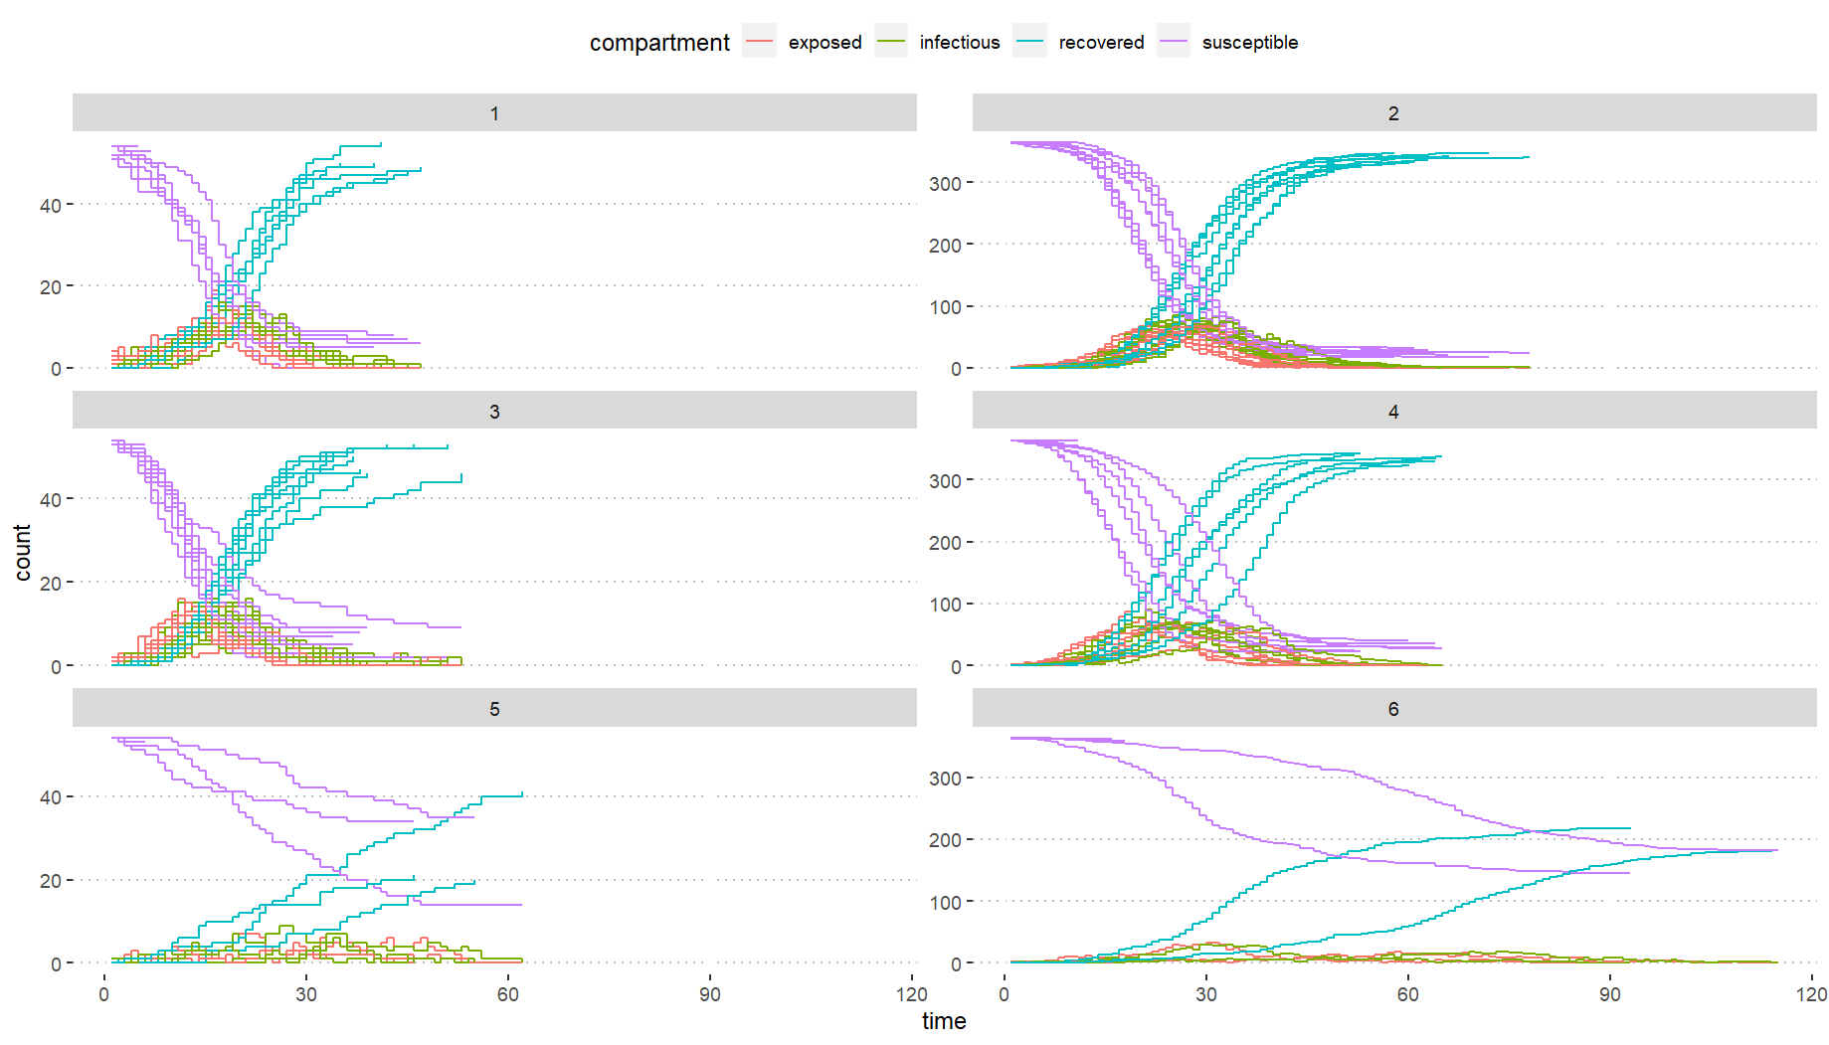
Small farm: Normal Spread
Big farm: Normal Spread
Small farm: removing pigs
Big farm: removing pigs
Small farm: vaccination
Big farm: vaccination

